Slide 1
Dynamic Computations in Ever-Changing Networks
Idit Keidar
Technion, Israel

Slide 2
TADDS: Theory of Dynamic
Distributed Systems
✓
?
✓
(This Workshop)

Slide 3
What I Mean By “Dynamic”*
A dynamic computation
  Continuously adapts its output
  to reflect input and environment changes
Other names
  Live, on-going, continuous, stabilizing
*In this talk ☺

Slide 4
In This Talk: Three Examples
Continuous (dynamic) weighted matching
Live monitoring
  (Dynamic) average aggregation)
Peer sampling
  Aka gossip-based membership

Slide 5
Ever-Changing Networks*
Where dynamic computations are interesting
Network (nodes, links) constantly changes
Computation inputs constantly change
  E.g., sensor reads
Examples:
  Ad-hoc, vehicular nets – mobility
  Sensor nets – battery, weather
  Social nets – people change friends, interests
  Clouds spanning multiple data-centers – churn
*My name for “dynamic” networks ☺

Slide 6
Continuous Weighted Matching in Dynamic Networks
Dynamic
Ever-Changing
With Liat Atsmon Guz, Gil Zussman

Slide 7
Weighted Matching
Motivation: schedule transmissions in wireless network
Links have weights, w:E→ℝ
  Can represent message queue lengths, throughput, etc.
Goal: maximize matching weight
M_{opt} – a matching with maximum weight
5
4
8
w(M_{opt})=17
2
10
3
9
1

Slide 8
Model
Network is ever-changing, or dynamic
  Also called time-varying graph, dynamic communication network, evolving graph
  E_{t},V_{t} are time-varying sets, w_{t} is a time-varying function
Asynchronous communication
No message loss unless links/node crash
  Perfect failure detection

Slide 9
Continuous Matching Problem
At any time t, every node v∈ V_{t} outputs either ⊥ or a neighbor u∈ V_{t} as its match
If the network eventually stops changing, then eventually, every node v outputs u
iff u outputs v
Defining the matching at time t:
  A link e=(u,v) ∈ M_{t}, if both u and v output each other as their match at time t
  Note: matching defined pre-convergence

Slide 10
Classical Approach to Matching
One-shot (static) algorithms
Run periodically
  Each time over static input
Bound convergence time
  Best known in asynchronous networks is O(|V|)
Bound approximation ratio at the end
  Typically 2
Don’t use the matching while algorithm is running
  “Control phase”

Slide 11
Self-Stabilizing Approach
[Manne et al. 2008]
Run all the time
  Adapt to changes
But, even a small change can destabilize the entire matching for a long time
Still same metrics:
  Convergence time from arbitrary state
  Approximation after convergence

Slide 12
Our Approach: Maximize Matching “All the Time”
Run constantly
  Like self-stabilizing
Do not wait for convergence
  It might never happen in a dynamic network!
Strive for stability
  Keep current matching edges in the matching as much as possible
Bound approximation throughout the run
  Local steps can take us back to the approximation quickly after a local change

Slide 13
Continuous Matching Strawman
Asynchronous matching using Hoepman’s (1-shot) Algorithm
  Always pick “locally” heaviest link for the matching
  Convergence in O(|V|) time from scratch
Use same rule dynamically: if new locally heaviest link becomes available, grab it and drop conflicting links

Slide 14
Strawman Example 1
12
11
10
9
W(M_{opt})=45
11
10
9
8
7
W(M)=20
Can take Ω(|V|) time to converge to approximation!
12
11
10
9
11
10
9
8
7
W(M)=21
12
11
10
9
11
10
9
8
7
W(M)=22
2-approximation
reached
12
11
10
9
11
10
9
8
7
W(M)=29

Slide 15
Strawman Example 2
9
10
8
9
7
6
W(M)=24
9
10
8
9
7
6
W(M)=16
9
10
8
9
7
6
W(M)=17
Can decrease the matching weight!

Slide 16
DynaMatch Algorithm Idea
Grab maximal augmenting links
  A link e is augmenting if adding e to M increases w(M)
  Augmentation weight w(e)-w(M∩adj(e)) > 0
  A maximal augmenting link has maximum augmentation weight among adjacent links
augmenting
but NOT maximal
9
maximal
augmenting
4
3
7
1

Slide 17
Example 2 Revisited
More stable after changes
Monotonically increasing matching weight
9
10
8
9
7
6

Slide 18
Example 1 Revisited
Faster convergence to approximation
12
11
10
9
11
10
9
8
7
12
11
10
9
11
10
9
8
7

Slide 19
General Result
After a local change
  Link/node added, removed, weight change
Convergence to approximation within constant number of steps
  Even before algorithm is quiescent (stable)
  Assuming it has stabilized before the change

Slide 20
LiMoSense – Live Monitoring in Dynamic Sensor Networks
Dynamic
Ever-Changing
With Ittay Eyal, Raphi Rom
ALGOSENSORS'11

Slide 21
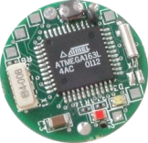
The Problem
7
5
In sensor network
  Each sensor has a read value
Average aggregation
  Compute average of read values
Live monitoring
  Inputs constantly change
  Dynamically compute “current” average
Motivation
  Environmental monitoring
  Cloud facility load monitoring
12
10
11
8
22
23
5

Slide 22
Requirements
Robustness
  Message loss
  Link failure/recovery – battery decay, weather
  Node crash
Limited bandwidth (battery), memory in nodes (motes)
No centralized server
  Challenge: cannot collect the values
  Employ in-network aggregation

Slide 23
Previous Work: One-Shot Average Aggregation
Assumes static input (sensor reads)
Output at all nodes converges to average
Gossip-based solution [Kempe et al.]
  Each node holds weighted estimate
  Sends part of its weight to a neighbor
10,0.5
8,1.5
8.5, ..
8.5, ..
10,1
7,1
10,0.5
Invariant: read sum =
weighted sum at all nodes and links

Slide 24
LiMoSense: Live Aggregation
Adjust to read value changes
Challenge: old read value may have spread to an unknown set of nodes
Idea: update weighted estimate
  To fix the invariant
Adjust the estimate:

Slide 25
Adjusting The Estimate
Example: read value 0 → 1
Before
After
3,1
4,1
Case 1:
3,2
3.5,2
Case 2:

Slide 26
Robust Aggregation Challenges
Message loss
  Breaks the invariant
  Solution idea: send summary of all previous values transmitted on the link
Weight → infinity
  Solution idea: hybrid push-pull solution, pull with negative weights
Link/node failures
  Solution idea: undo sent messages

Slide 27
Correctness Results
Theorem 1: The invariant always holds
Theorem 2: After GST, all estimates converge to the average
Convergence rate: exponential decay of mean square error

Slide 28
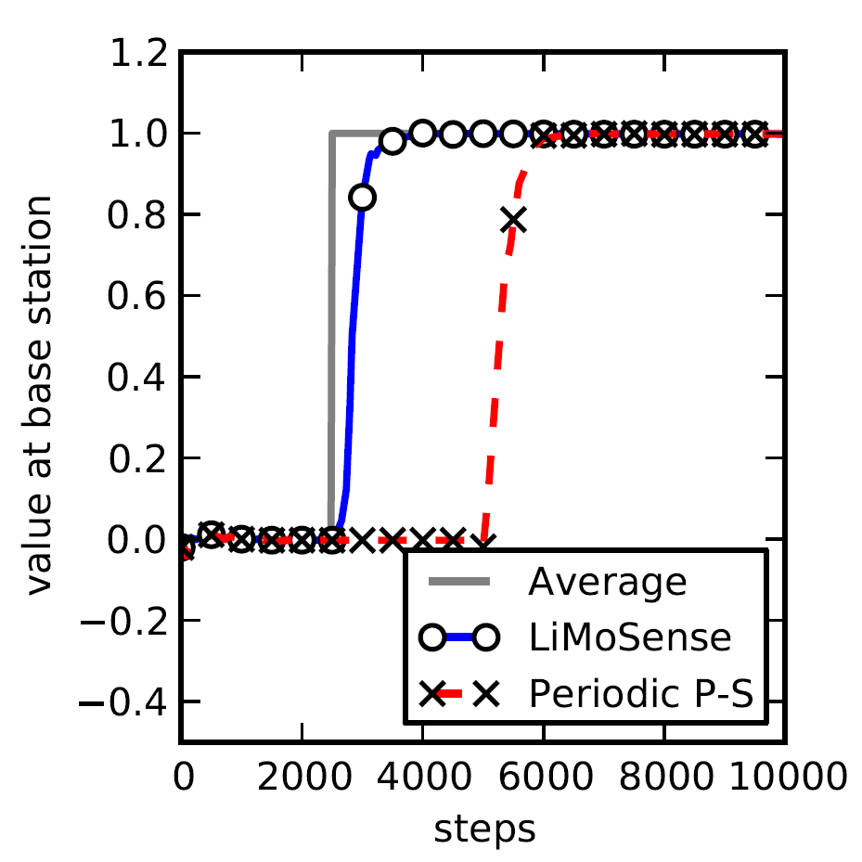
Simulation Example
100 nodes
Input: standard normal distribution
10 nodes change
  Values +10

Slide 29
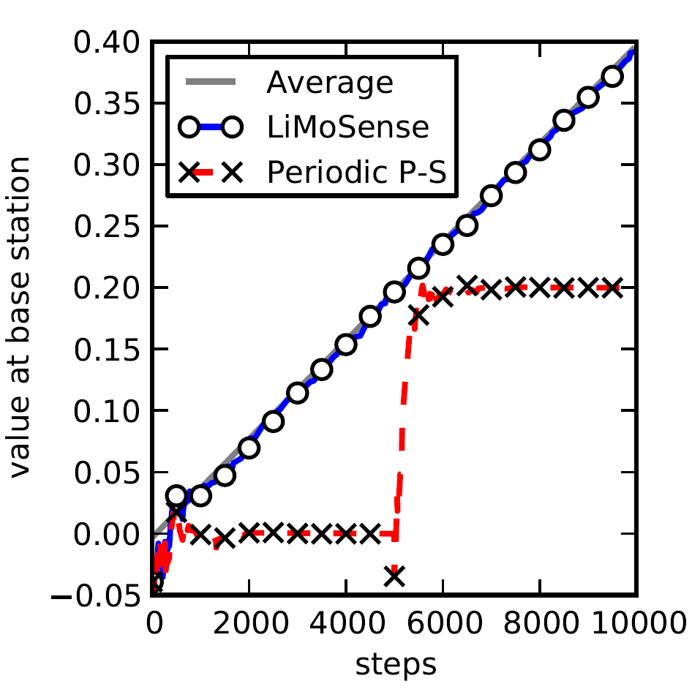
Simulation Example 2
100 nodes
Input: standard normal distribution
Every 10 steps,
  10 nodes change values +0.01

Slide 30
Summary
LiMoSense – Live Average Monitoring
  Aggregate dynamic data reads
Fault tolerant
  Message loss, link failure, node crash
Correctness in dynamic asynchronous settings
Exponential convergence after GST
Quick reaction to dynamic behavior

Slide 31
Correctness of Gossip-Based Membership under Message Loss
Dynamic
With Maxim Gurevich
PODC'09; SICOMP 2010

Slide 32
The Setting
Many nodes – n
  10,000s, 100,000s, 1,000,000s, …
Come and go
  Churn (=ever-changing input)
Fully connected network topology
  Like the Internet
Every joining node knows some others
  (Initial) Connectivity

Slide 33
Membership or Peer Sampling
Each node needs to know some live nodes
Has a view
  Set of node ids
  Supplied to the application
  Constantly refreshed (= dynamic output)
Typical size – log n

Slide 34
Applications
Applications
  Gossip-based algorithm
  Unstructured overlay networks
  Gathering statistics
Work best with random node samples
  Gossip algorithms converge fast
  Overlay networks are robust, good expanders
  Statistics are accurate

Slide 35
Modeling Membership Views
Modeled as a directed graph
w
y
v | y | w | …
u
v

Slide 36
Modeling Protocols: Graph Transformations
View is used for maintenance
Example: push protocol
w
z
w
v | … | w | …
… | … | w | …
… | … | z | …
u
v

Slide 37

Desirable Properties?
Randomness
  View should include random samples
Holy grail for samples: IID
  Each sample uniformly distributed
  Each sample independent of other samples
    Avoid spatial dependencies among view entries
    Avoid correlations between nodes
  Good load balance among nodes
Notes:
Picture holy grail

Slide 38
What About Churn?
Views should constantly evolve
  Remove failed nodes, add joining ones
Views should evolve to IID from any state
Minimize temporal dependencies
  Dependence on the past should decay quickly
  Useful for application requiring fresh samples

Slide 39
Global Markov Chain
A global state – all n views in the system
A protocol action – transition between global states
Global Markov Chain G
u
v
u
v

Slide 40
Defining Properties Formally
Small views
  Bounded dout(u)
Load balance
  Low variance of din(u)
From any starting state, eventually
(In the stationary distribution of MC on G)
  Uniformity
    Pr(v ∈ u.view) = Pr(w ∈ u.view)
  Spatial independence
    Pr(v ∈ u. view| y ∈ w. view) = Pr(v ∈ u. view)
  Perfect uniformity + spatial independence → load balance

Slide 41
Temporal Independence
Time to obtain views independent of the past
From an expected state
  Refresh rate in the steady state
Would have been much longer had we considered starting from
arbitrary state
  O(n¹⁴) [Cooper09]

Slide 42
Existing Work: Practical Protocols
Push protocol
w
z
w
z
u
v
u
v
w
Tolerates asynchrony, message loss
Studied only empirically ☹
  Good load balance [Lpbcast, Jelasity et al 07] ☺
  Fast decay of temporal dependencies [Jelasity et al 07] ☺
  Induce spatial dependence ☹
Notes:
Add citations

Slide 43
Existing Work: Analysis
w
z
Shuffle protocol
*
… | … | w | …
v | … | w | …
… | … | z | …
v | … | z | …
u
v
w
z
Analyzed theoretically [Allavena et al 05, Mahlmann et al 06]
  Uniformity, load balance, spatial independence ☺
  Weak bounds (worst case) on temporal independence ☹
Unrealistic assumptions – hard to implement ☹
  Atomic actions with bi-directional communication
  No message loss
Notes:
Add citations

Slide 44
Our Contribution :
Bridge This Gap
A practical protocol
  Tolerates message loss, churn, failures
  No complex bookkeeping for atomic actions
Formally prove the desirable properties
  Including under message loss

Slide 45
Send & Forget Membership
The best of push and shuffle
w
Some view
entries may
be empty
u | w
u
v
… | …
v | … | w | …
 |  | u | w
Perfect randomness without loss

Slide 46
S&F: Message Loss
Message loss
  Or no empty entries in v’s view
w
w
u
v
u
v

Slide 47
S&F: Compensating for Loss
Edges (view entries) disappear due to loss
Need to prevent views from emptying out
Keep the sent ids when too few ids in view
  Push-like when views are too small
  But rare enough to limit dependencies
w
w
u
v
u
v

Slide 48
S&F: Advantages
No bi-directional communication
  No complex bookkeeping
  Tolerates message loss
Simple
  Without unrealistic assumptions
  Amenable to formal analysis
Easy to implement

Slide 49
Key Contribution: Analysis
Degree distribution (load balance)
Stationary distribution of MC on global graph G
  Uniformity
  Spatial Independence
  Temporal Independence
Hold even under (reasonable) message loss!

Slide 50
Conclusions
Ever-changing networks are here to stay
In these, need to solve dynamic versions of network problems
We discussed three examples
  Matching
  Monitoring
  Peer sampling
Many more have yet to be studied

Slide 51
Thanks!
Liat Atsmon Guz, Gil Zussman
Ittay Eyal, Raphi Rom
Maxim Gurevich

